Slide 1
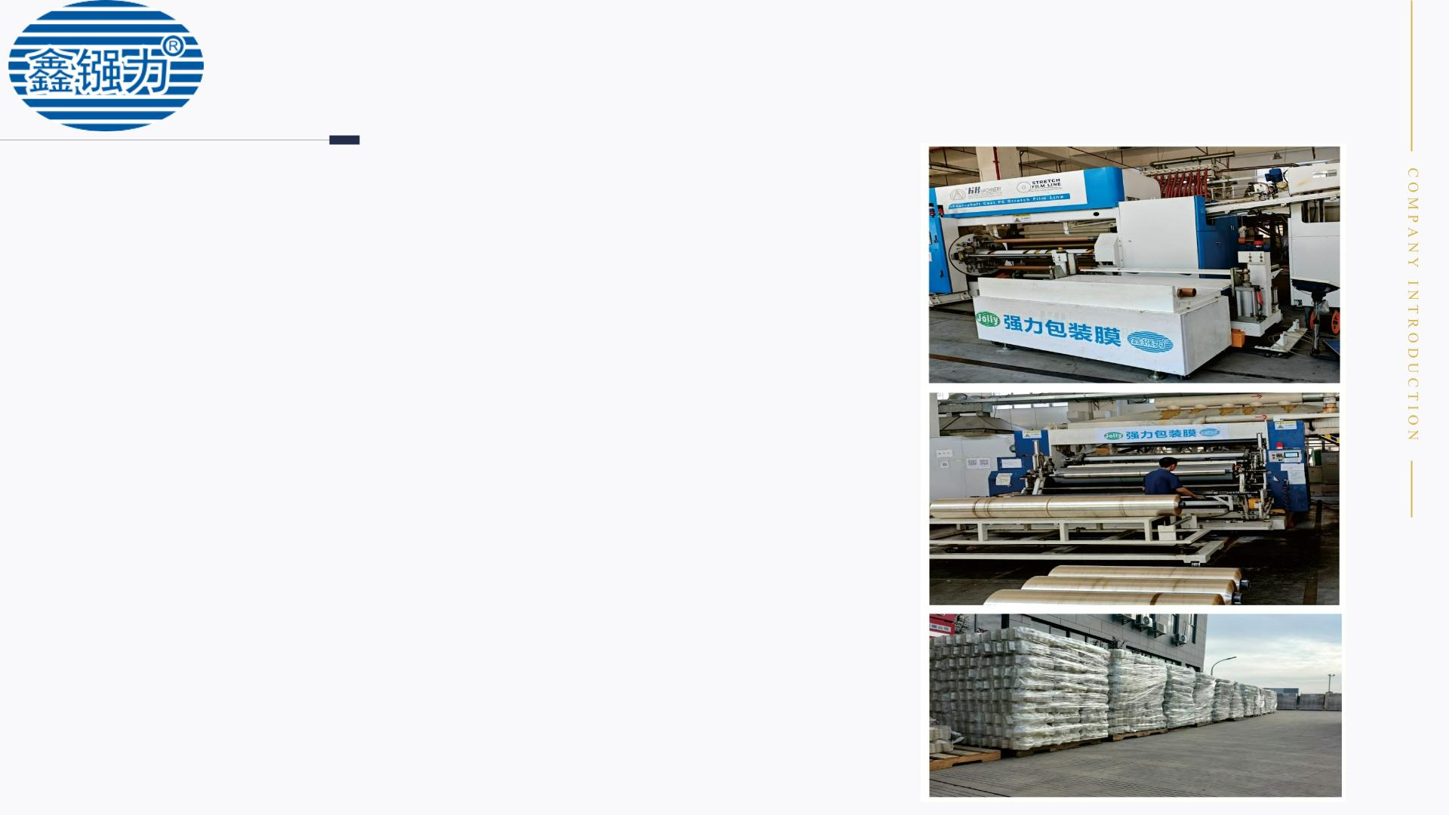
COMPANY PROFILE
Kunshan Qianli Packaging Materials Co., Ltd. is a modern plastic film
production enterprise that integrates independent research and
development, production, and sales. Our main products include PVC film,
PE film, shrink film, printing film, rust proof film, woven fabric, packaging
tape, etc. We cooperate with customers to develop and customize
according to their needs, including various special requirements, quality,
specifications, etc.
Our company has accumulated a group of high-quality technical
talents through years of self accumulation, formed a scientific management
system and quality assurance, and our products have a high reputation in
the same industry. We have established a good reputation among our
customer base and served over 5232+customers. And it has passed the
IS09001 quality system certification.
Company mission: Continuously innovating solutions and materials to
break through boundaries, solving packaging problems in the wire and
cable industry, adding value to customer products and reducing costs, and
making life better for powerful people.

Slide 2

ENSURE CORE
BUSINESS
PVC wire and cable film
PE wrapping film
PVC machine shaking plate film, PVC hand wire
film, complete specifications support customization,
customizable width (2cm-3M), thickness (1-30
wires), pipe core (gypsum core, paper tube, rubber
tube), color (natural color, green, blue, etc.)
Hand machine wrapping film, PE machine shaking disc
machine film, PE wire film, complete specifications
support customization, customizable width (3cm-2M),
thickness (1-6), core (paper tube, rubber tube), color
(white, blue, black, red, etc.)
Wire and cable heat shrink film
Printing PVC film
PE heat shrink film, folded shrink film, width and
thickness can be customized according to needs,
matched with special blue packing tape
Support PVC film printing of LOGO text content, etc
Cable shaft outer envelope
Machine woven snake skin fabric
Cable shaft outer coating, rainproof film, supports
customization: color, length, width, customized logo,
etc
Machine made snake skin woven fabric supports
customized lengths; Width, density, thickness, color,
coating, etc
Polyester tape
strap
Customization is available upon request.
PET plastic steel packaging comes in specifications such as
1608, 1912, and supports customization of width,
thickness, color, length, and texture.There are also PP
strapping and tough strapping

Slide 3
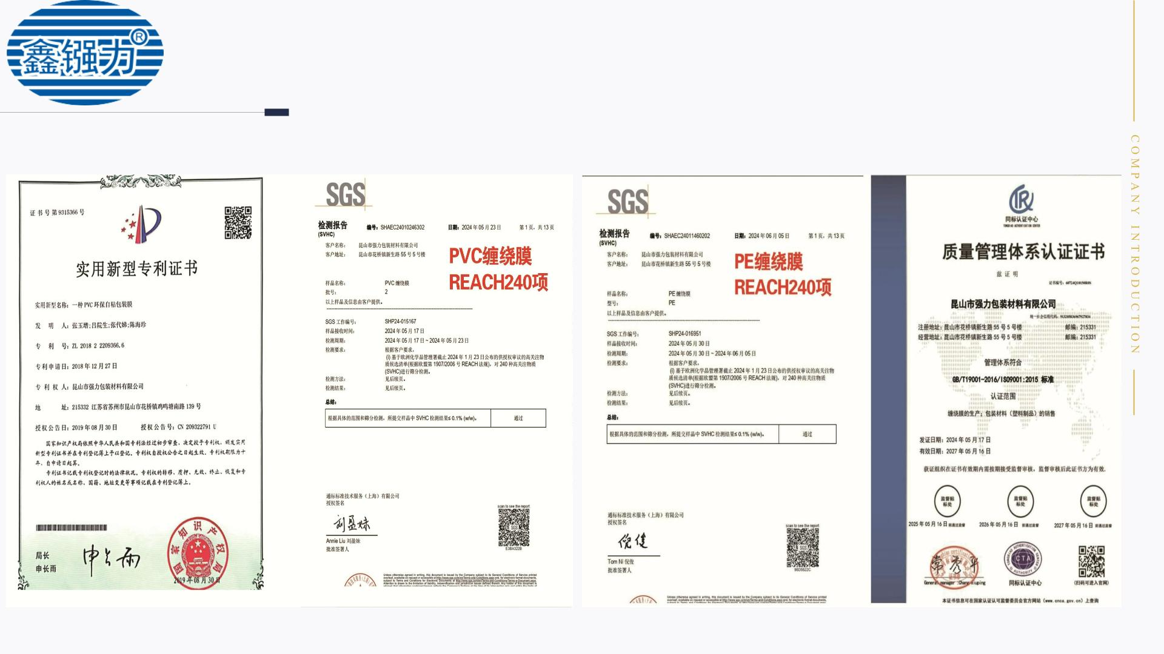
QUALIFICATION
CERTIFICATE

Slide 4
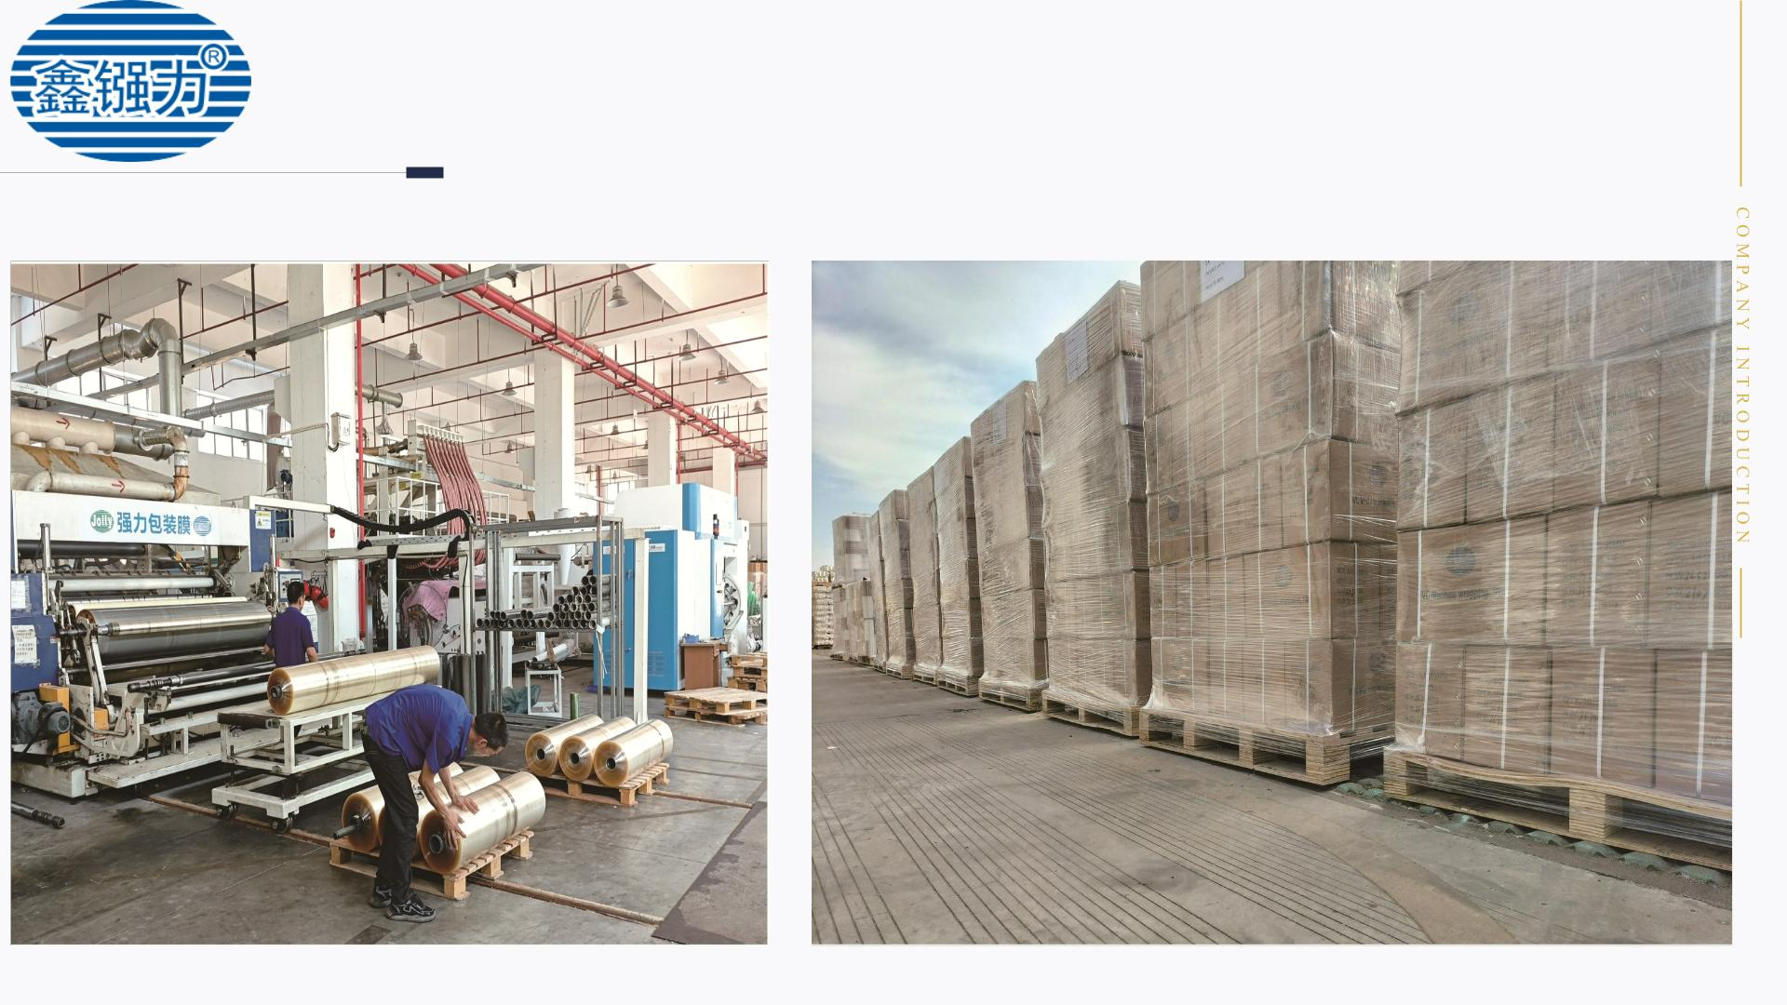
FACTORY
SHOOTING

Slide 5
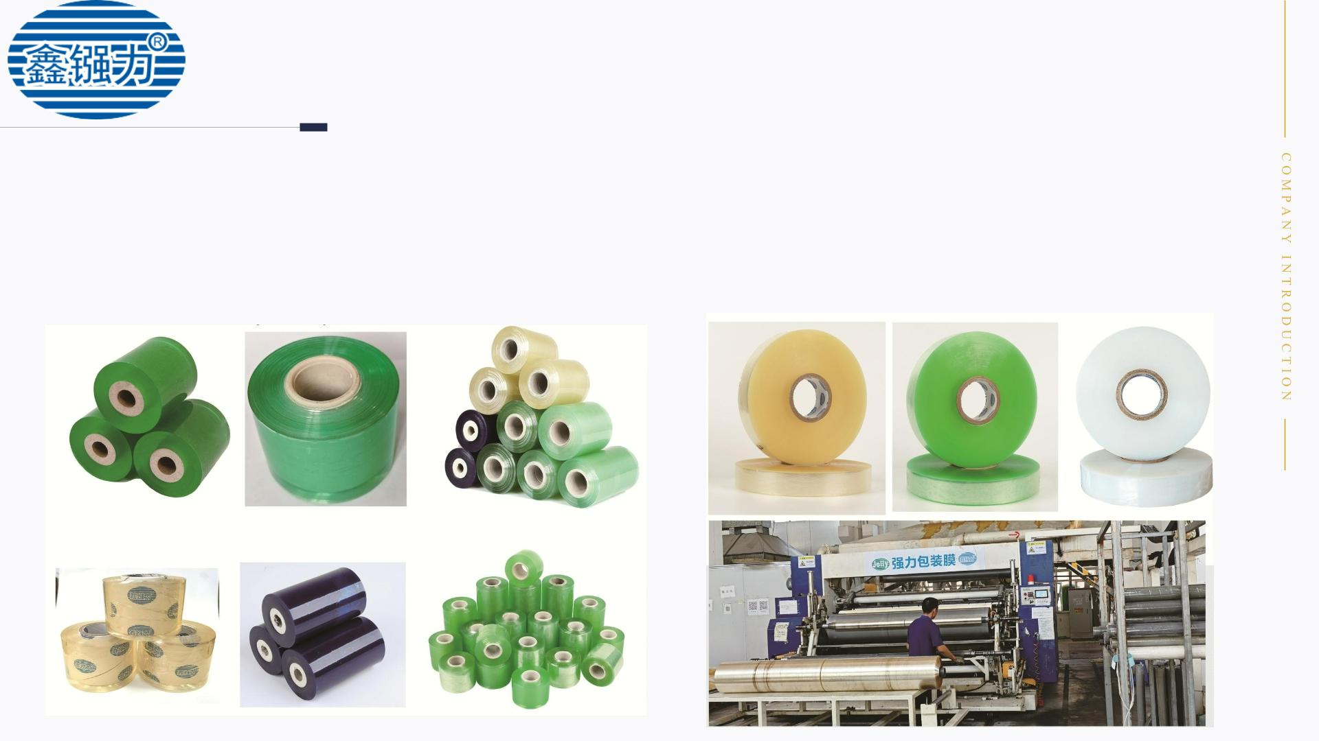
PVC WIRE FILM
PVC small roll film
Packaging film for shaking machine
The small roll film has a complete range of
Special packaging film for shaking machine, complete
specifications support customization, customizable width
(3.5cm/4cm/4.2cm to 1.5M), thickness (1-15 threads), tube
core (paper tube, rubber tube), color (white, blue, black, red,
etc.), length (customized length as needed), material (PE/PVC
optional)
specifications and supports customization. It can be
customized in width (2cm-3M), thickness (1-15 threads),
core (gypsum core, paper core, rubber core), color (natural
color, green, blue, yellow, etc.), length (customized
according to needs), and has ROHS1.0/20. and REACH 240
items that comply w th env ronmental protection.

Slide 6
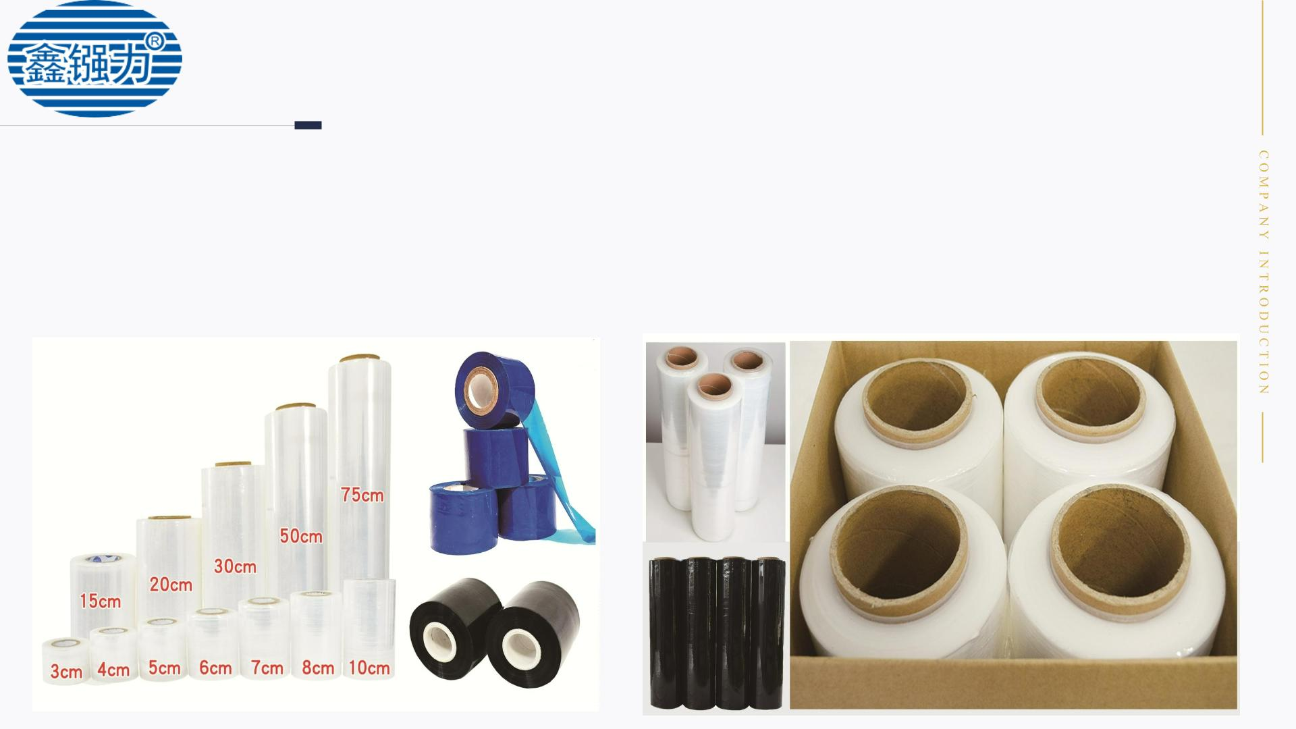
PE WRAPPING FILM
PE small roll film
PE machine film
The small roll film has a complete range of
Machine film includes wrapping film for rocking machines,
pallet packaging film, and logistics packaging film. Complete
specifications support customization, customizable width
(3.5cm/4cm/4.2cm to 1.5M), thickness (1-6 wires), tube core
(paper tube, rubber tube), color (white, blue, black, red, etc.),
length (customized length as needed), metallocene (added in
proportion as needed)
specifications and supports customization. It can be
customized in width (3cm-2M), thickness (1-6 threads),
tube core (paper core, rubber core), color (white, black,
blue, yellow, etc.), length (customized as needed),
stretching 1:5, and meets the requirements of
environmental protection REACH 240.

Slide 7
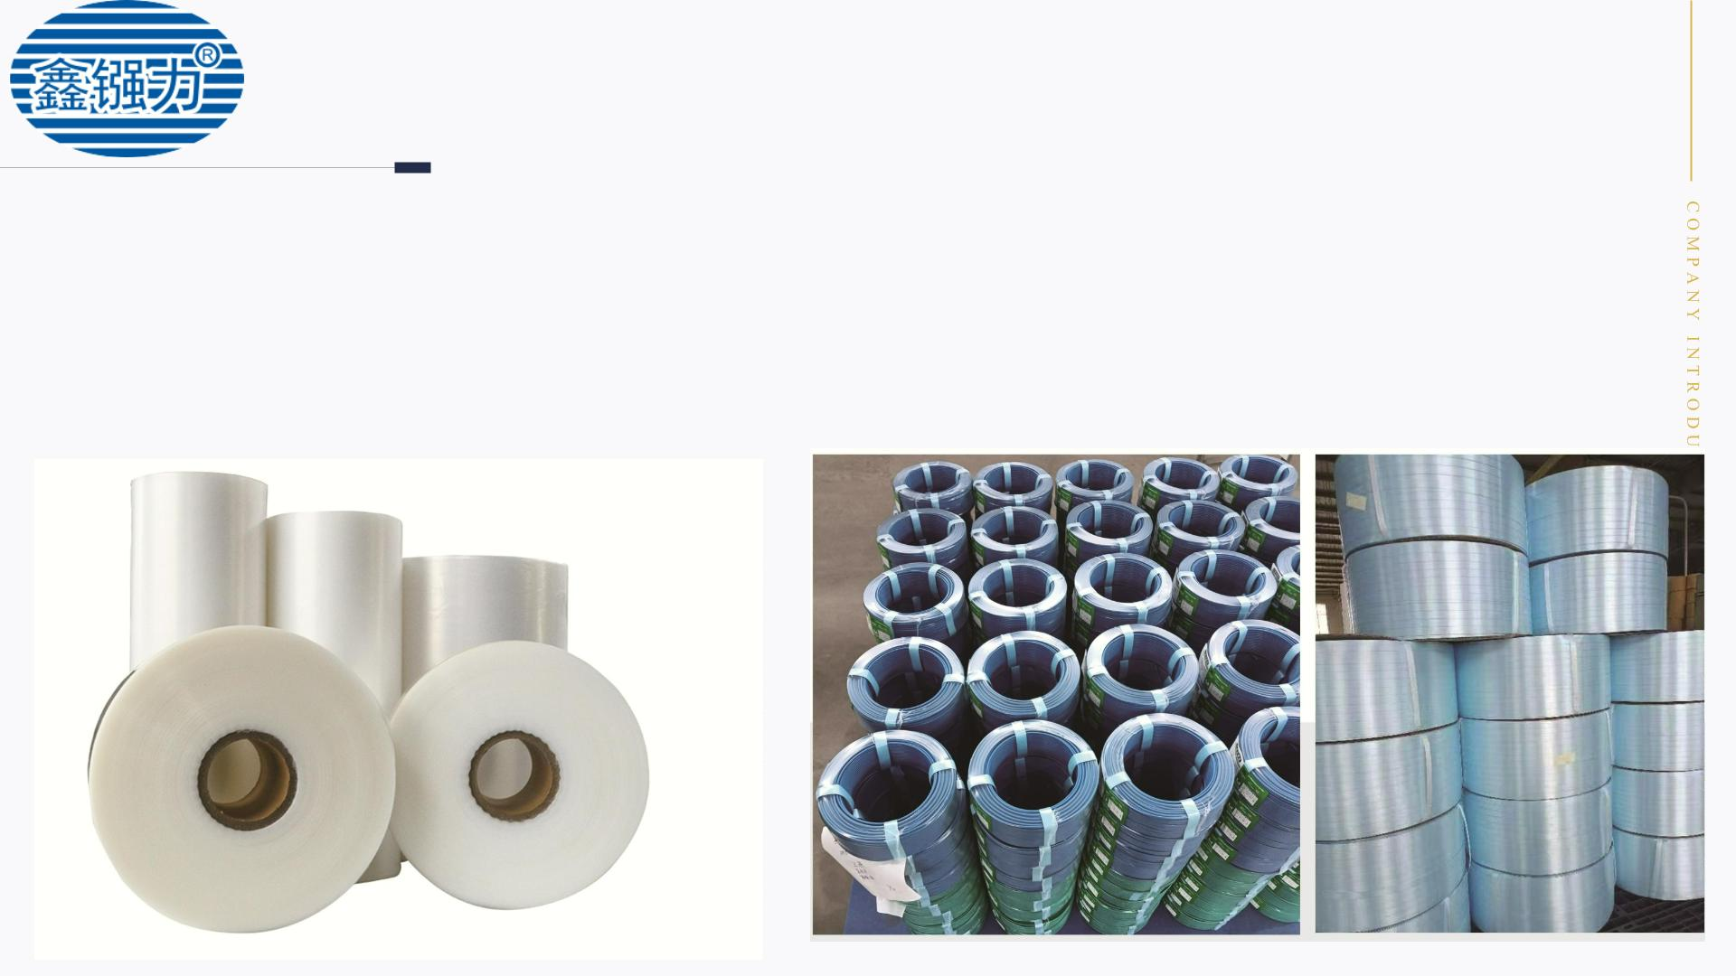
PE HEAT SHRINK FILM
PE heat shrink film
PVC heat shrink film+blue
packing tape (14.8 * 0.5mm)
Specially designed for packaging wire and cable
heat shrink film, customizable in width (12cm-
100cm), thickness (regular 6-wire, customizable
thickness), core (paper core inner hole 7.6cm),
folding (folding, cuffs can be customized as
needed), and length (customized as needed).
Specially designed for packaging wire and cable
heat shrink film, customizable width, thickness
(customizable thickness), tube core (paper core),
color (regular white, blue), length (customized as
needed)。

Slide 8
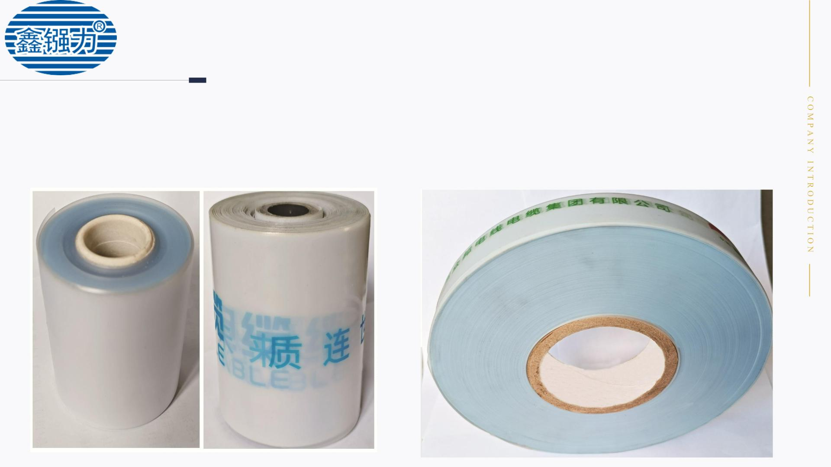
PRINTING PVC
WRAPPING FILM
Printing PVC hand film
Printing PVC machine film
Handheld film can print content, with complete
Packaging film for shaking machine, with complete specifications
and support for customization. It can be customized with width
(conventional 3.5cm/4cm), thickness, core (paper tube, rubber
tube), color, and length (customized length as needed)
specifications and support for customization. It can be
customized in width, thickness, tube core (paper core,
rubber core), color, and length (customized as needed)。

Slide 9
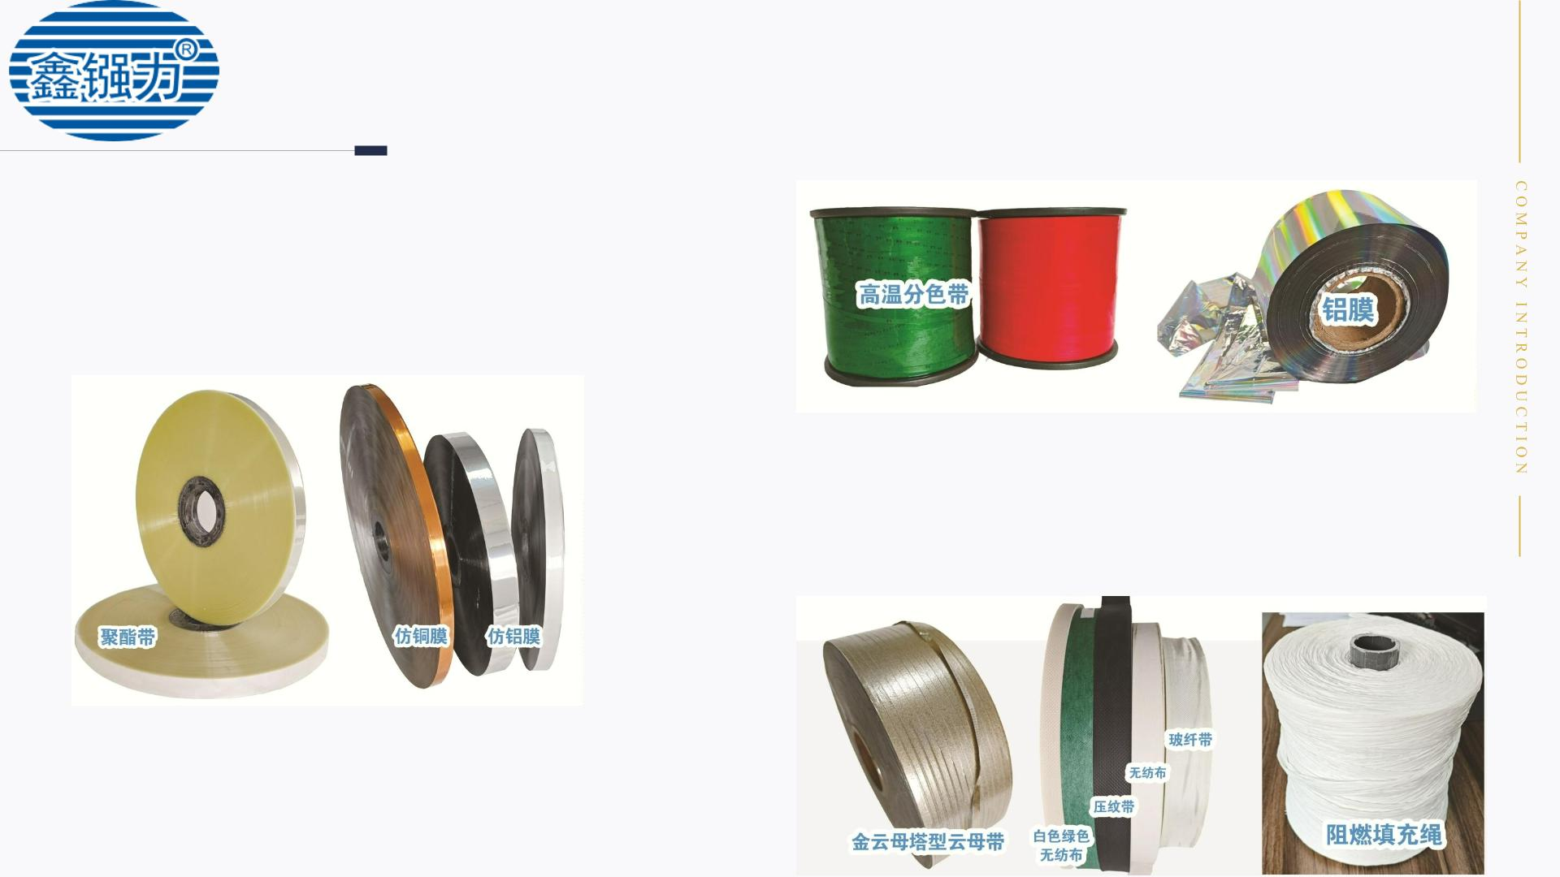
VARIOUS FILLERS
FOR CABLES
Polyester tape, imitation copper film,
imitation aluminum film
Complete specifications support customization, with
customizable width, thickness, material, and length
(customized as needed) 。
Mica tape, non-woven
fabric, flame-retardant filling
rope
Complete specifications support customization, with customizable
width, thickness, color, and length
High temperature color separation
tape, aluminum film
Complete specifications support customization, with customizable
width, thickness, color, and length

Slide 10
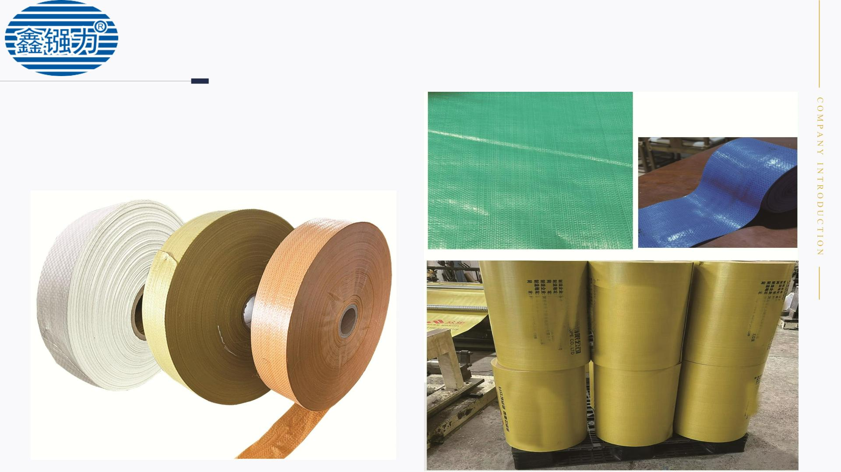
PVC wrapping film
Machine snake skin cloth
Machine made snake skin fabric can be coated with film,
with complete specifications supporting customization. It
can be customized in width, thickness, tube core (paper
core), color, and length (as needed).

Slide 11
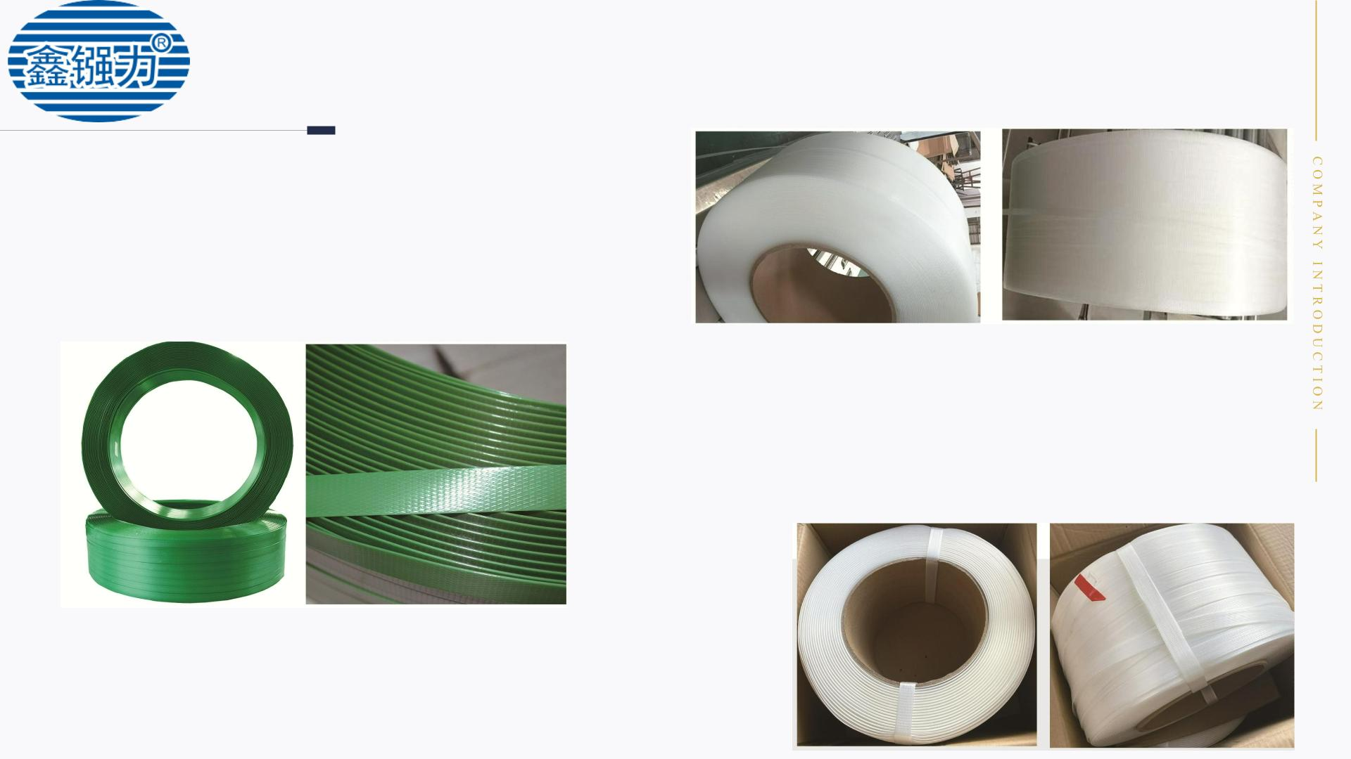
strap
PET plastic steel strapping
Plastic steel strapping comes in a complete range of specifications
and supports customization. Regular stock includes 1608.1912, etc. It
can be customized with width (2cm-3M), thickness (0.8mm-15mm),
embossing (customizable smooth surface without embossing or
pressure embossing), color (green, gray, black, yellow, etc.), and length
(customized as needed).
Resilient packing tape
PE strapping comes in a complete range of specifications and
supports customization. Regular stock includes 1208.1412, etc. It can
be customized in width (1.2cm-3M), thickness (0.8mm-15mm),
embossing (can be customized with smooth surface without
embossing or pressure embossing), color, and length (customized
according to needs).
PP packing tape
PE strapping comes in a complete range of specifications and supports
customization. Regular stock includes 1208.1412, etc. It can be customized in
width (1.2cm-3M), thickness (0.8mm-15mm), embossing (can be customized
with smooth surface without embossing or pressure embossing), color, and
length (customized according to needs).

Slide 12
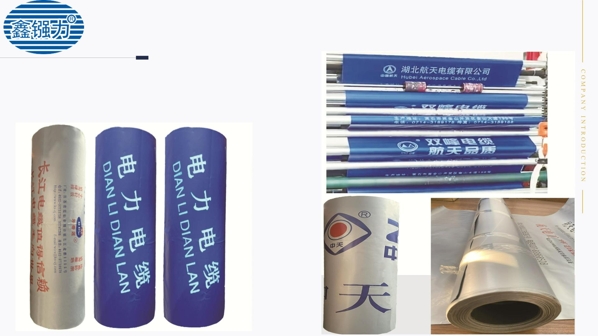
PE cable waterproof film
PE cable waterproof film
PE cable waterproof film with a standard thickness of 18 wires,
complete specifications support customization, customizable width,
thickness, color, and length (customized as needed) 。

Slide 13
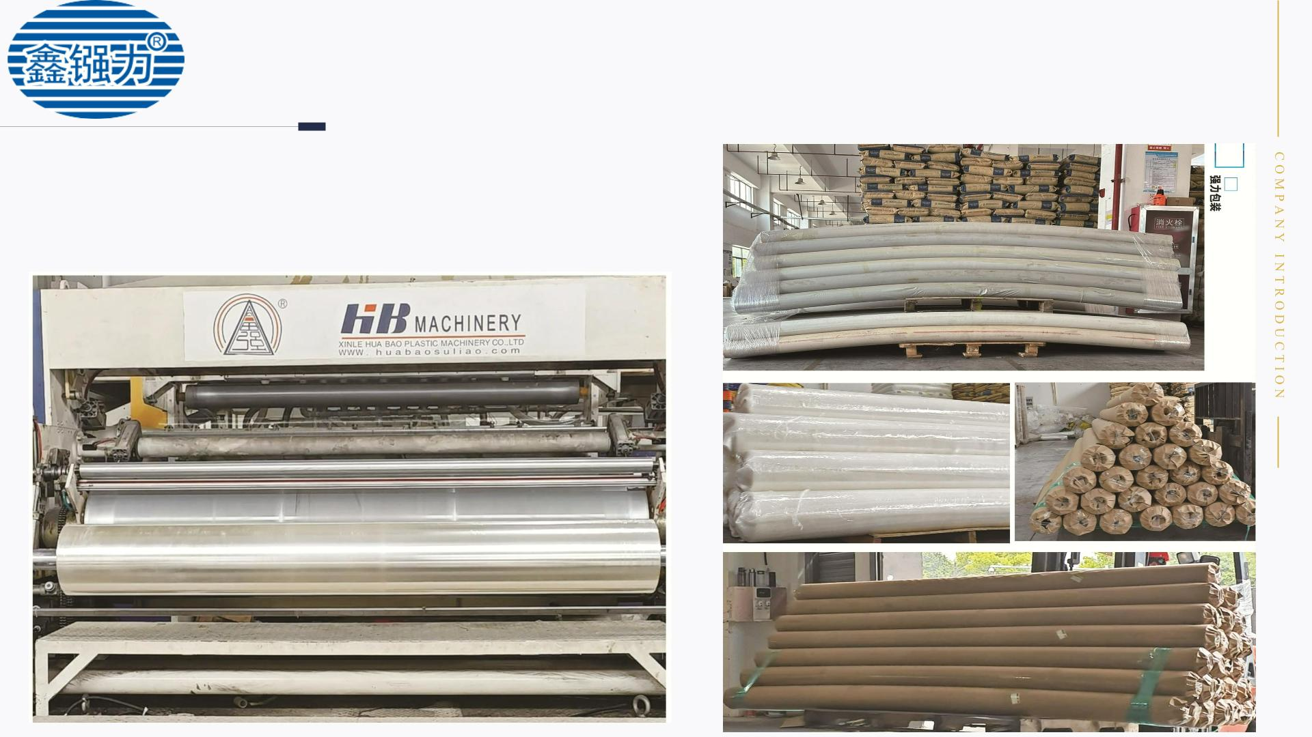
PVC glass film
PVC glass film
The glass film has complete specifications and supports
customization, including width, thickness, core (adhesive
core), color, and length (customized according to needs).

Slide 14
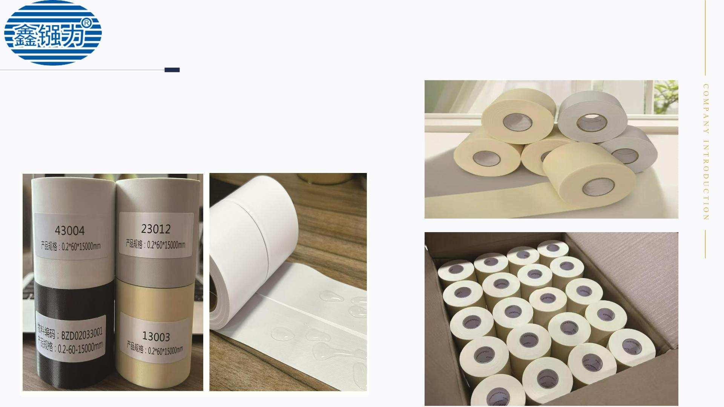
PVC air conditioning
cable tie
PVC air conditioning cable tie
The air conditioning cable ties come in a complete range of
specifications and support customization, including width,
thickness, core, color, and length. There is a testing report
and anti UV testing.

Slide 15
STRONG PACKAGING IS COMMITTED TO
PROVIDING YOU WITH THE BEST PACKAGING
SOLUTION!
Thanks♪(･ω･)ﾉ

